Slide 1
Array Processing
Strings

Slide 2
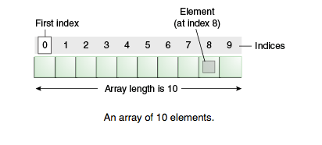
What is an Array?
Object used to store a list of values
All values in array are the same type
  E.g. int, double, char, string, etc.
Notes:
Sam

Slide 3
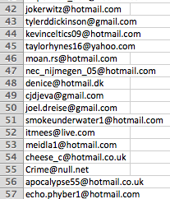
What is an Array?
Used to store a large number of data
Easy to access any element in the array
E.g. array to store a list of emails
Notes:
Sam

Slide 4
How to Declare
Declaring an array to hold up to 10 words:
Declaring an array and initializing variables at the same time:
String array[] = new String [10];
String[] array = {“Hi”,”Hello”,”Welcome”,”Goodbye”,”Farewell”};
Notes:
Sam

Slide 5
String Manipulation
length() to find the length of a string
stringName.charAt(0) will output the first character of a string. Each character in a string has a position. String positions start at 0.
stringName.indexOf(“T”) will output the index number that the letter T belongs to
stringName.substring(3) will output all characters after the index #
Eg: String stringName = “Jim hates math”
Output: “ hates math”

Slide 6
String Manipulation
stringName.substring(#, #)
First # is for the index that you want and last number is for the index that you don’t want
stringName2 = “ I hate math “
stringName2.trim() Output: “I hate math”
stringName.toLowerCase() makes every character a lower case letter
stringName.toUpperCase() makes every character an upper case letter

Slide 7
String Manipulation
concat()
stringname1.concat(stringName2) will put both strings into 1 word
stringName.replace(“a”, “p”); will replace every a with p
stringName1.equals(stringName2) will return true or false depending on whether the two contain the same value
stringName1.compareTo(stringName2) is for alphabetical order
If the condition above is >0, name1 is before name 2. <0, name1 is before name 2.

Slide 8
Sorting
public static void bubbleSort(int[] List){
boolean swap = true;
int j=1;
int temp;
while(swap==true){
do{
swap = false;
for(int i = 0; i<List.length-j; i++){
if(List[i]>List[i+1]){
temp = List[i];
List[i] = List[i+1];
List[i+1] = temp;
swap = true;
}
}
j++;
}while(swap);
for(int i = 0; i < List.length; i++){
System.out.println(List[i]);
}
}
}

Slide 9

Searching
boolean found;
System.out.println(“Enter the word you would like to search within the array”);
word = scanner.next();
for (int i = 0; i < array.length; i++) {
If (array[i].equals(word)) {
found = true;
break;
}
}

Slide 10
Searching (output)
if (found == true) {
System.out.println(“The letter entered has been found within the array”);
}else{
System.out.println(“The letter entered had not been found within the array”);
}

Slide 11
Searching (expanding)
int pos; // variable to hold position in the array
for (int i = 0; i < array.length; i++) {
If (array[i].equals(word)) {
found = true; // setting boolean found to true
pos = i; // holding the position in the array in pos
break;
}
}

Slide 12
Searching (output expanding)
If (found == true) {
System.out.println(“The word entered has been found within array “ + pos);
}else{
System.out.println(“The word entered had not been found within the array”);
}

Slide 13


Conclusion
Arrays are very useful when problem solving when a large number of data is involved
Organize large sets of data
Variety of ways you can access information in an array
Notes:
Sam

Slide 14
The End
Thank you for listening

